Slide 1
Photomicrographs of Plant foods
Tarragon
Permission to reproduce original photomicrographs used to make this collection may be obtained from
Dr. David O. Norris at
david.norris@colorado.edu

Slide 2
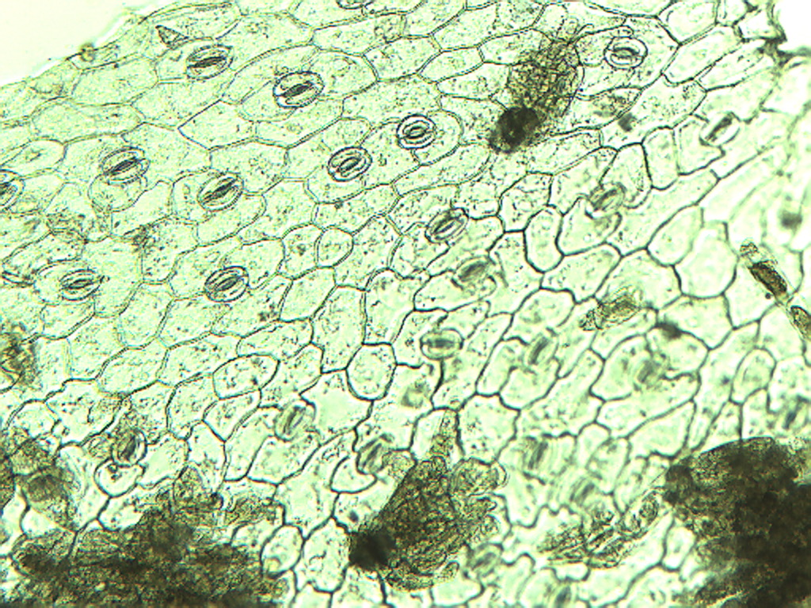
Notes:
481. Artemisia dracunculus L. Tarragon. Epidermal cells and stomates (arrows). 10X.

Slide 3
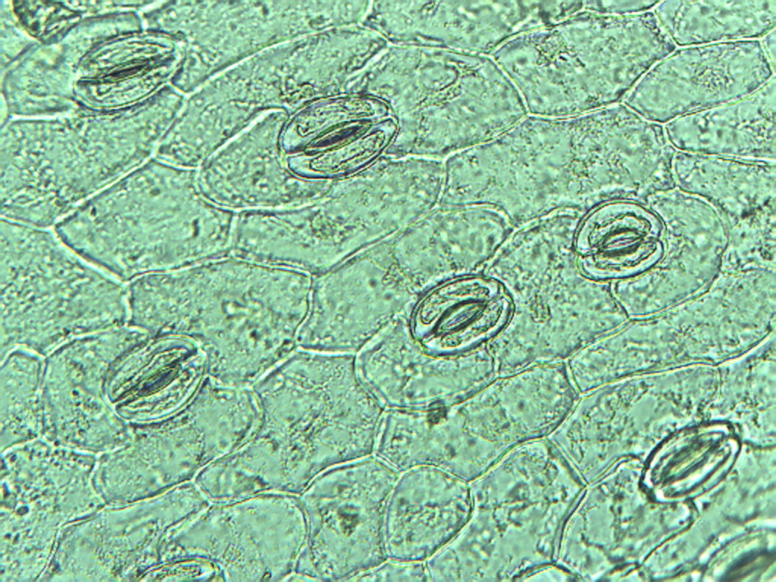
Notes:
482. Tarragon. Leaf stomates (arrrows), 25X

Slide 4
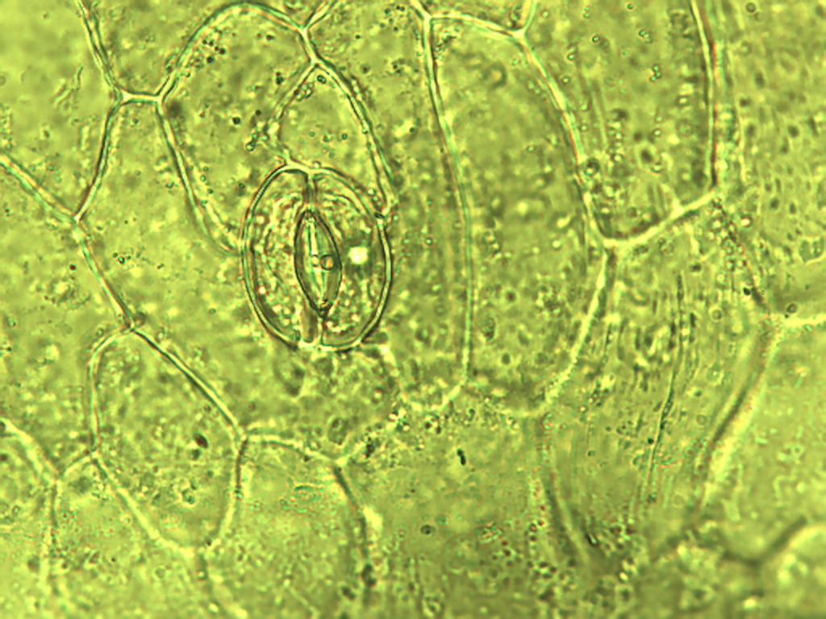
Notes:
483. Tarragon. Epidermal cells with stomate (arrow), 40X.

Slide 5
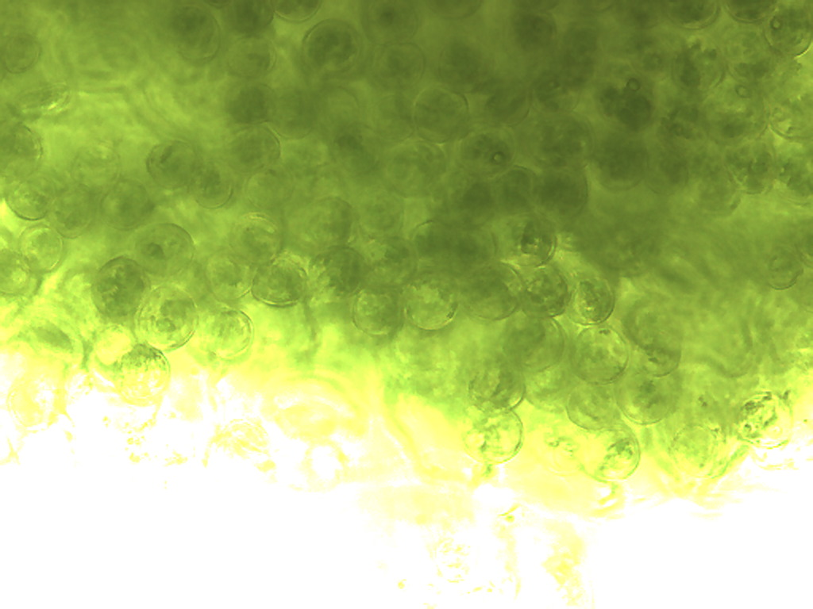
Notes:
484. Tarragon. Photosynthetic cells, 25X

Slide 6
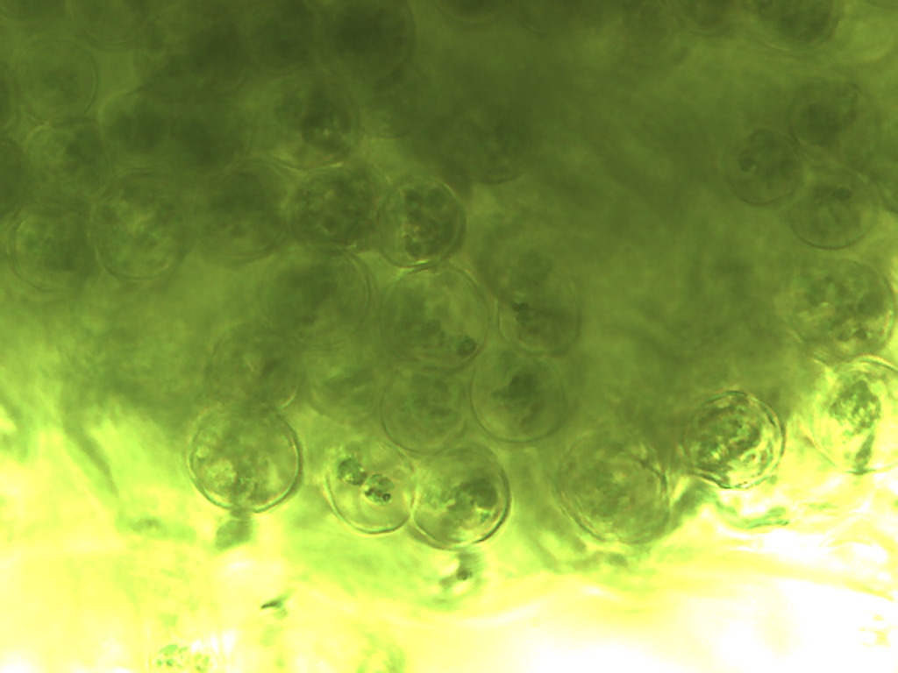
Notes:
Tarragon. 485. Photosynthetic parenchymal cells, 40X

Slide 7
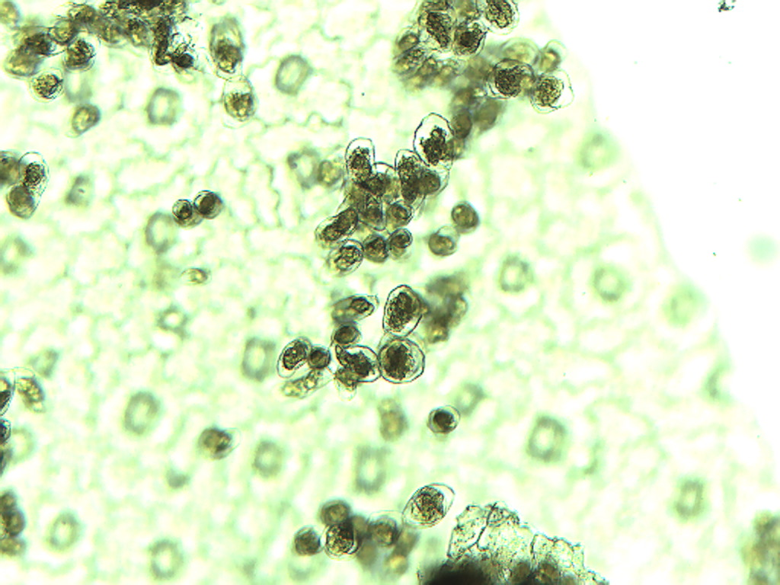
Notes:
486. Tarragon. Leaf photosynthetic parenchymal cells beneath epidermis, 10X.

Slide 8
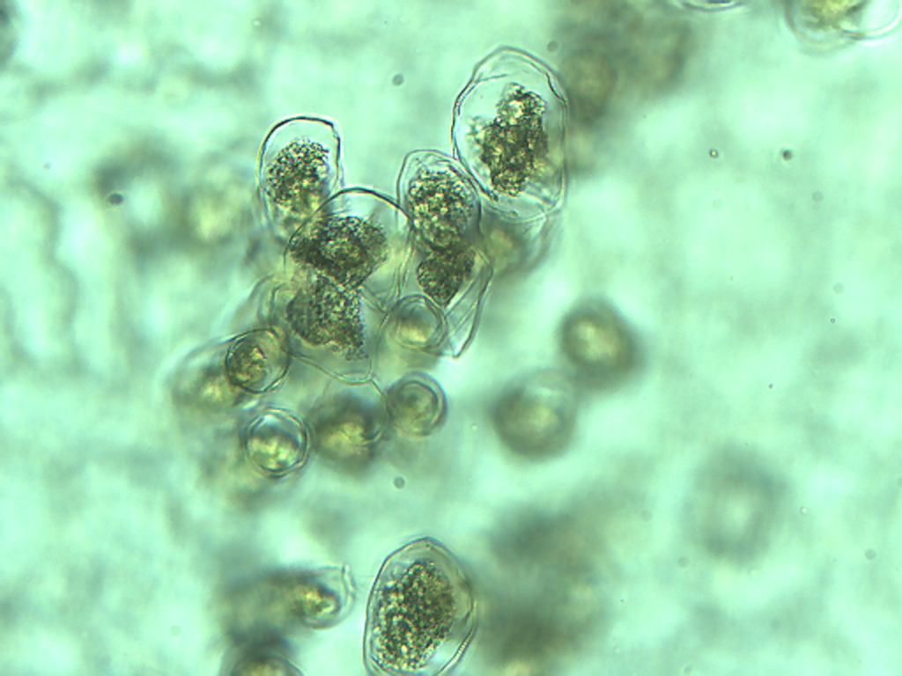
Notes:
487. Tarragon. Leaf photosynthetic parenchymal cells, 25X.

Slide 9
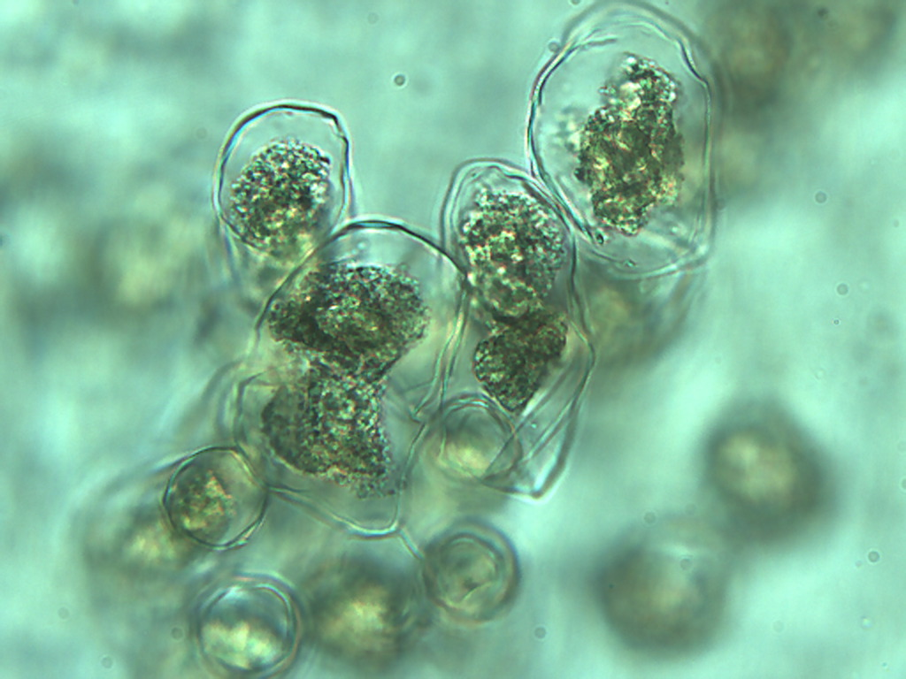
Notes:
488. Tarragon. Leaf photosynthetic parenchymal cells, 40X.

